Slide 1

Final Project
Formula 1

Slide 2
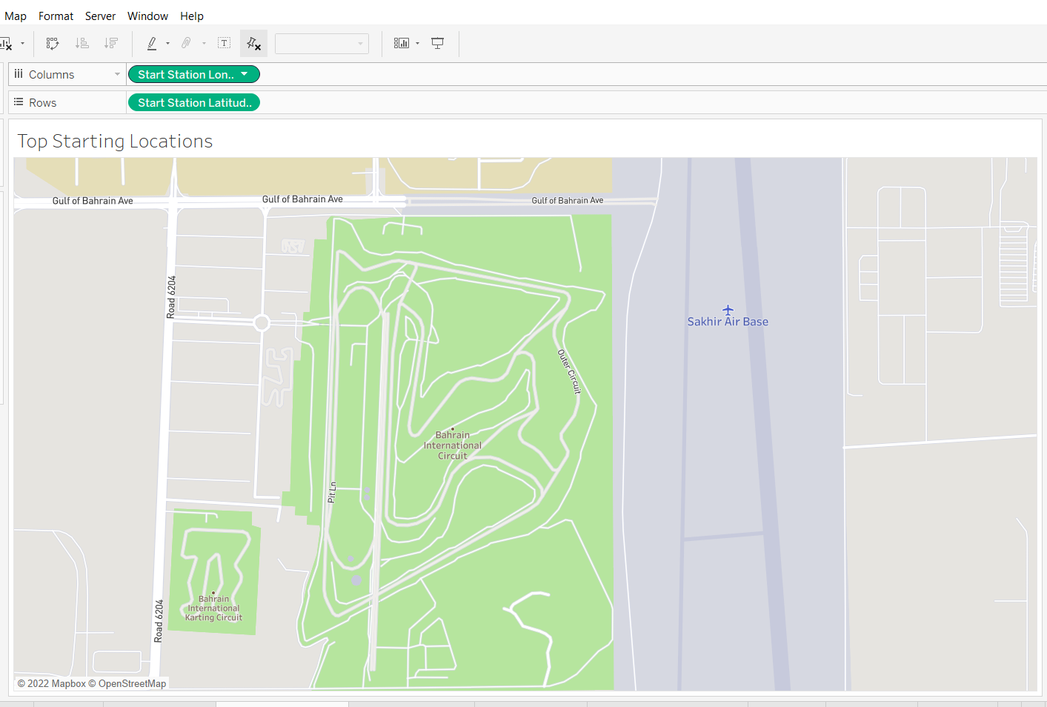
Interactive Tableau
Filters based on countries or drivers with stats.
Bar charts with the total points from 2021 of each driver
Set the interaction where you can hover over each country and when the circuit has started.
In each country, it’ll have the top 3 drivers name.
In the circuit, have all the drivers stats for that race.
When clicked, it will produce tables and charts that are listed in the next slide.

Slide 3
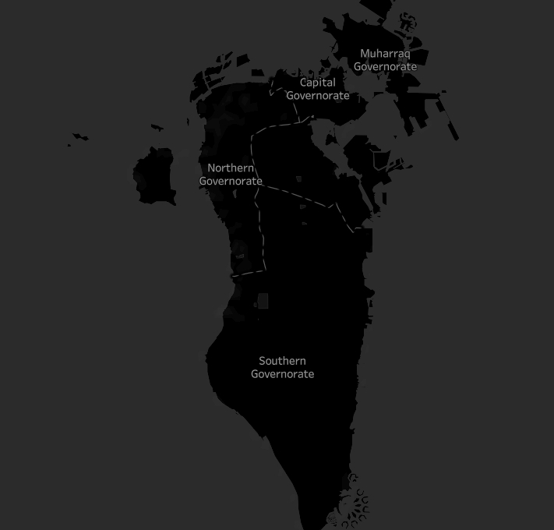
Country (Race)
Tables:
Race: Details - Driver Info, Position, Fastest Lap, Num stops and Total Time Stop
Graph: Number of stops with total time stop as the y-axis. Drivers as x-axis.
Graph: Show the
2nd Table: Starting Grid Position, Starting Grid Qualifying Time, Q times
Graph: Stacked graph for the Q’ times.
3rd Table: Practice positions and time
Graph: Line Graph to show the time and position

Slide 4
Storyboard
Formulate total averages table of all races for each driver for points, positioning, grid positioning, avg speed, Q times, practice position, num stops, stop total time.
Once we discover the features that meets the linear regression, develop graphs of the specific tables that align the winning factors.

Slide 5
Least Weighted Dataset
Laps (unless we could use the highest laps as an indicator)
Time/Retired
Stop Lap, Stop TOD, Stop Time since Stop Total Time is the total.
Qualifying Laps
Practice Laps, Practice Gap
Notes:
Should we use this data in our visuals?

